Slide 1

IOT Inventory Portal
progress report
03 Jul, 2019

Slide 2

Sign in page

Slide 3
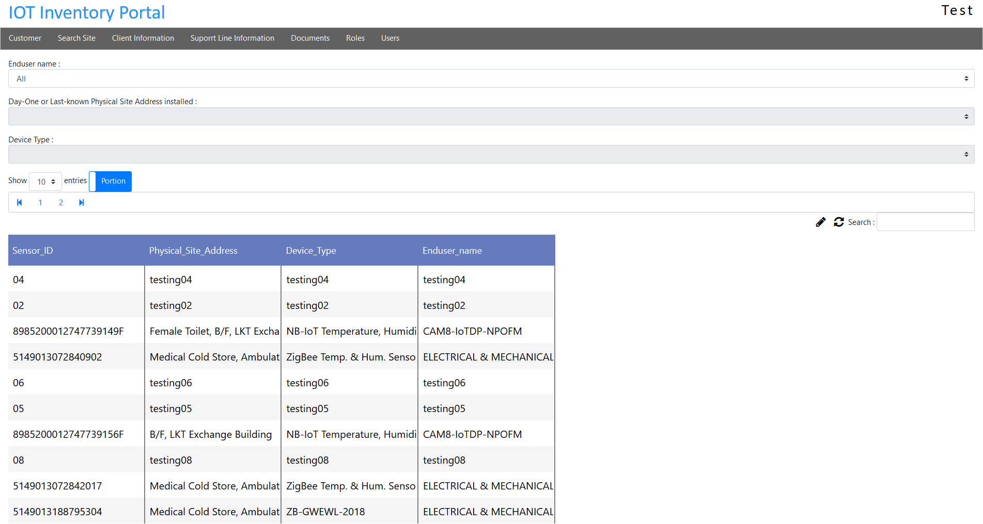
Overview

Slide 4
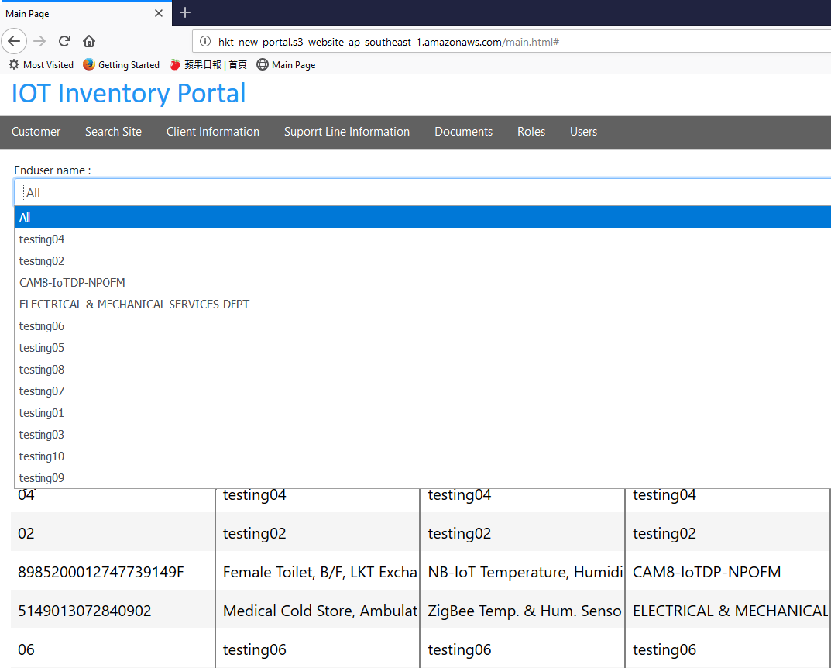
Select particular field

Slide 5
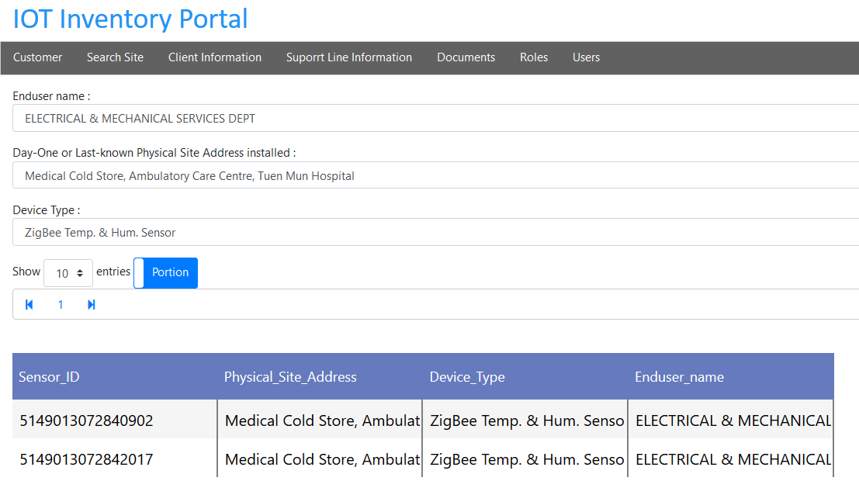
Select particular field (continue)

Slide 6
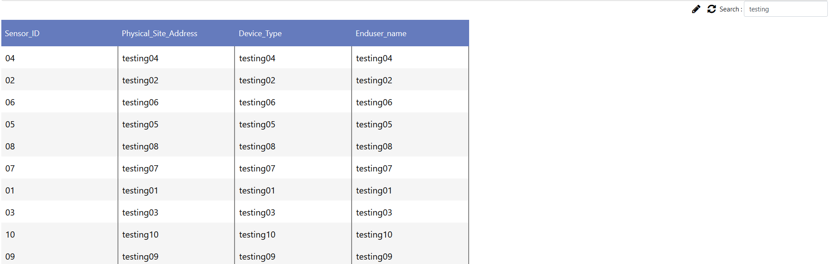
Search for keywords

Slide 7
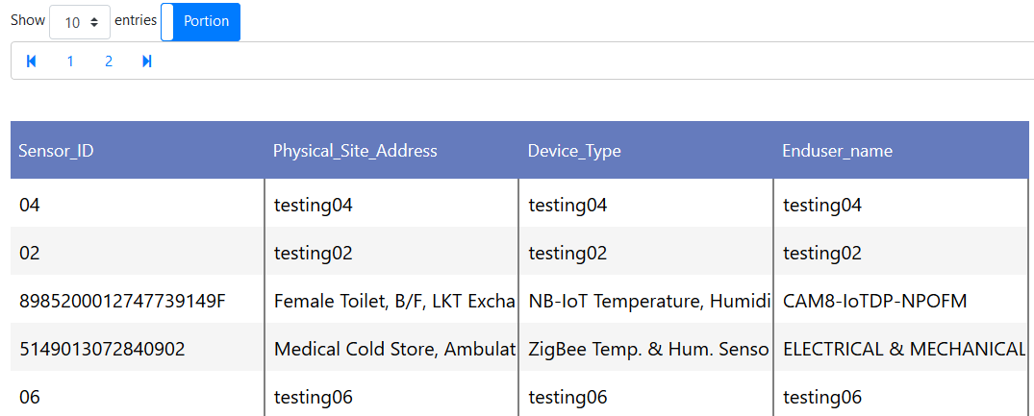
Show portion fields

Slide 8
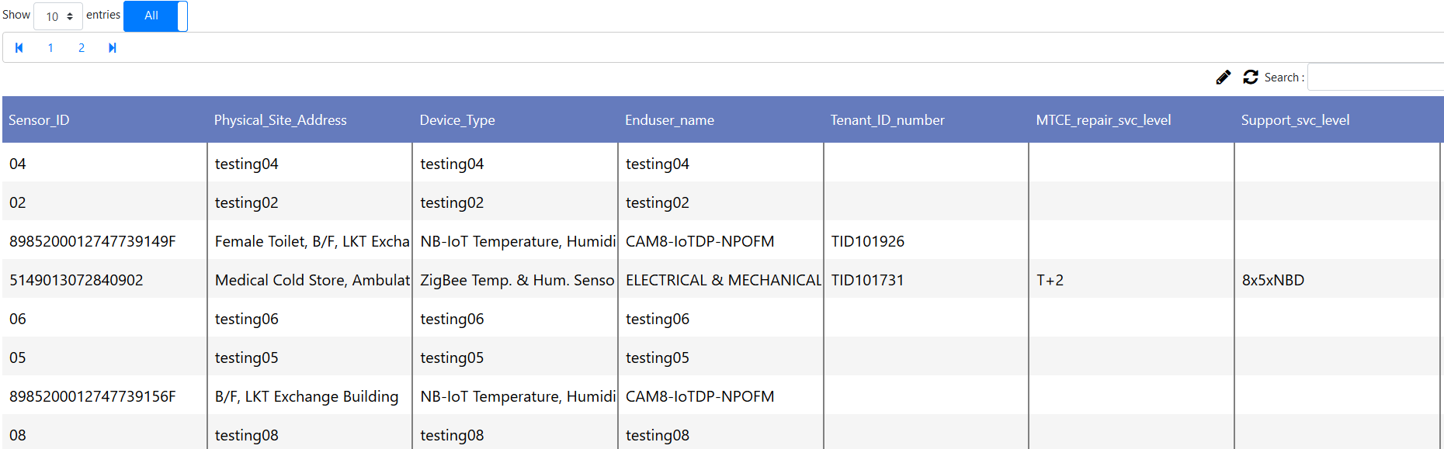
Show all fields

Slide 9
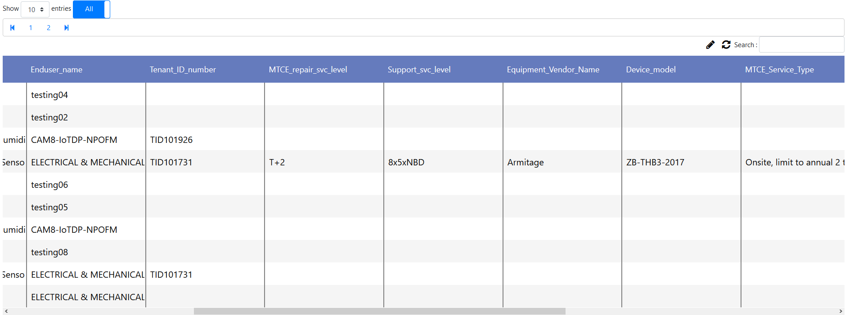
Show all fields (continue)

Slide 10
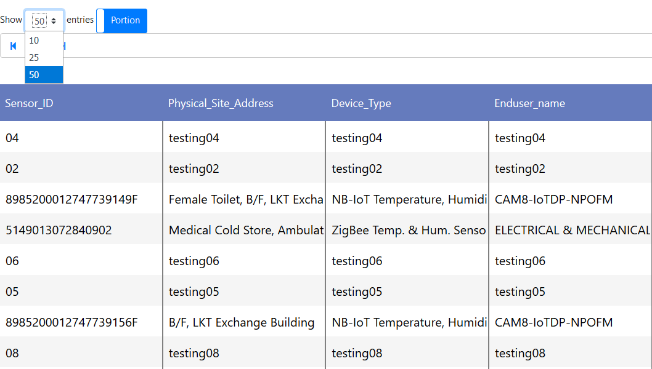
Select the number of entries to be showed

Slide 11
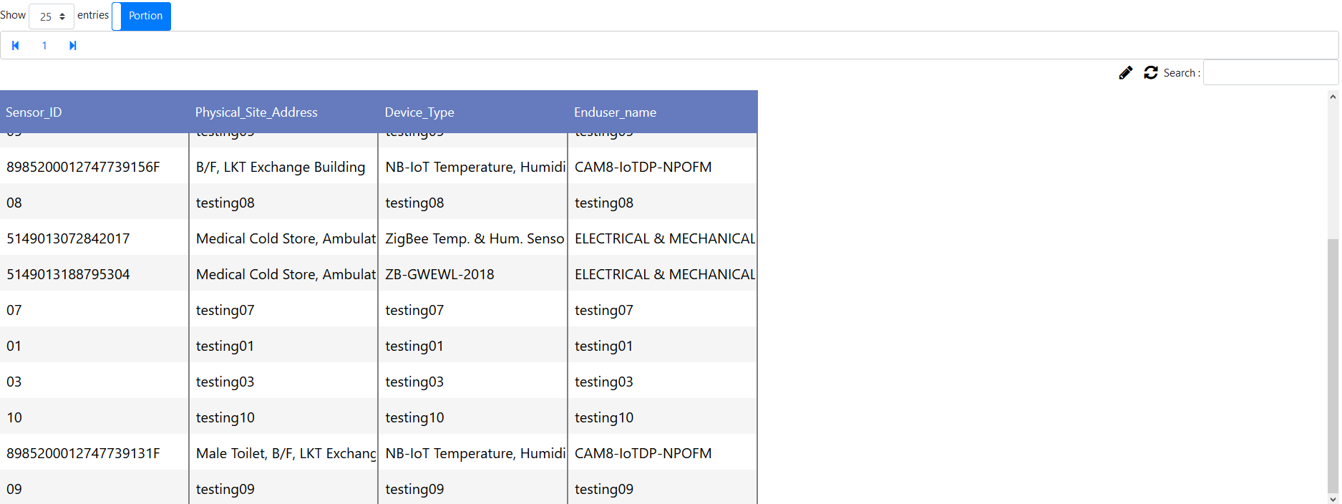
Select the number of entries to be showed (continue)

Slide 12
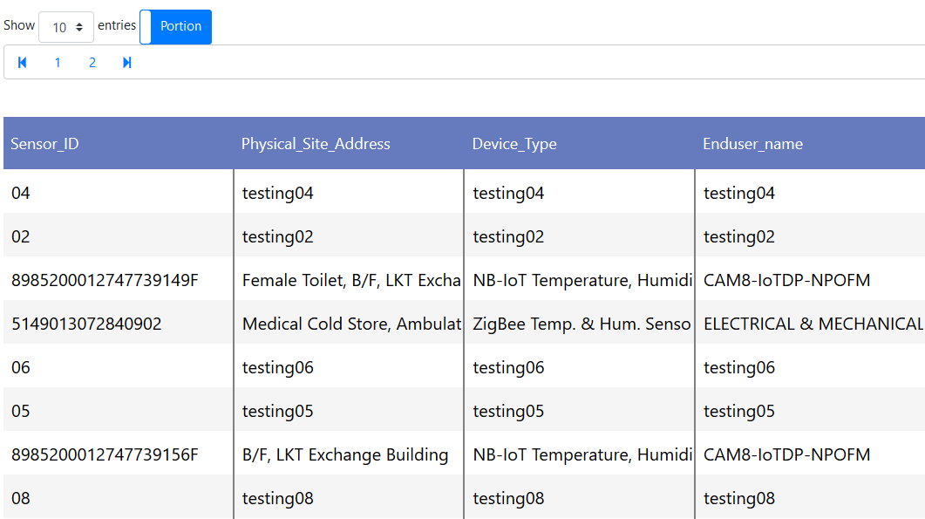
Pagination(Go to the First/Last Page)

Slide 13
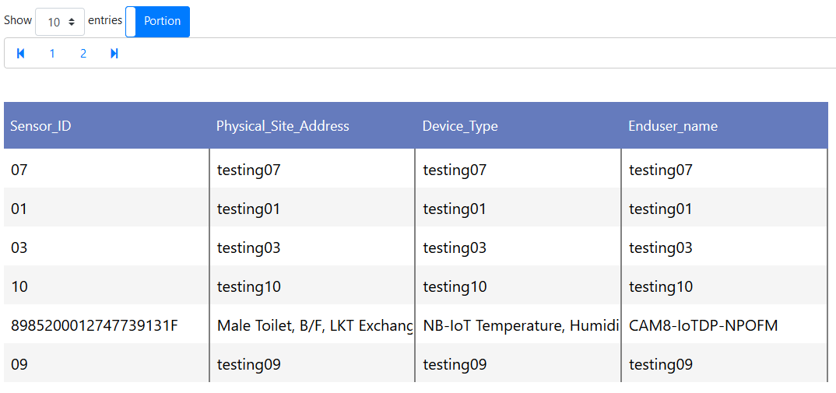
Pagination (Second Page)

Slide 14
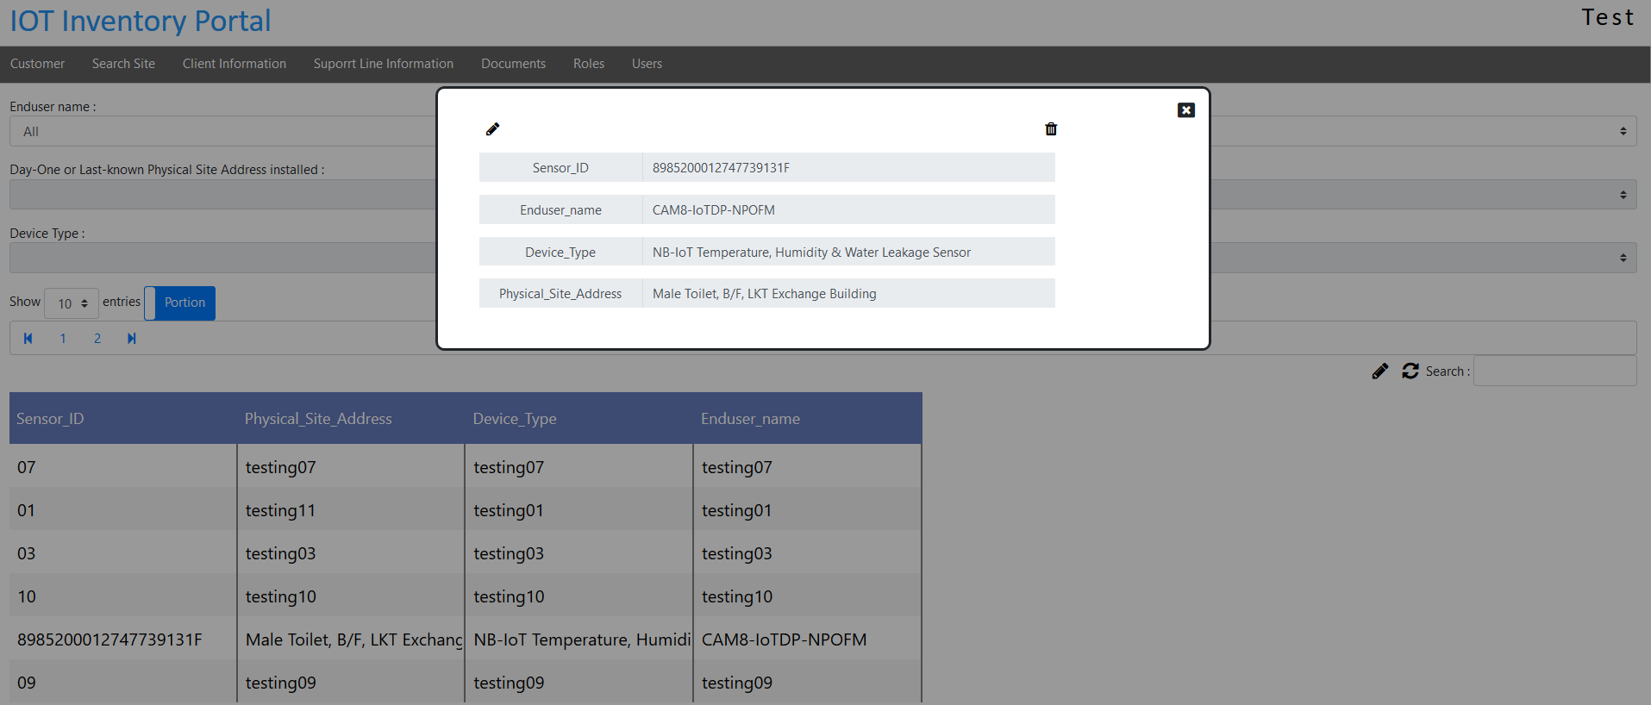
Show particular entry

Slide 15
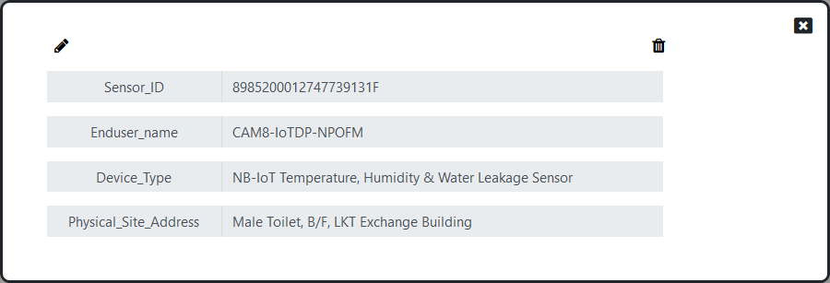
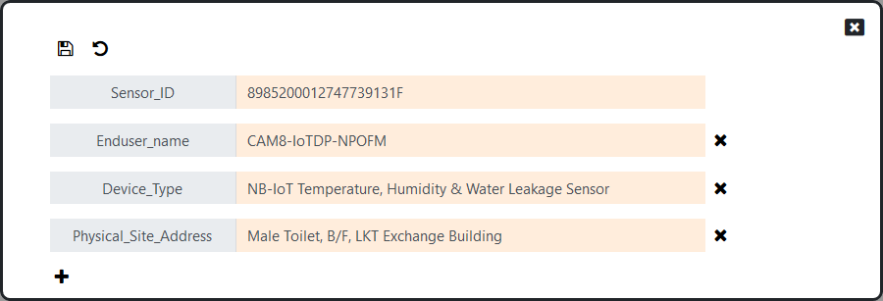
Show particular entry (continue)
Delete the
entire entry
Close the window
Edit the entry
The fields and records are editable

Slide 16
Show particular entry (continue)
Rollback (Cancel)
Save the changed
(Confirm)
Delete particular record
Add new record

Slide 17
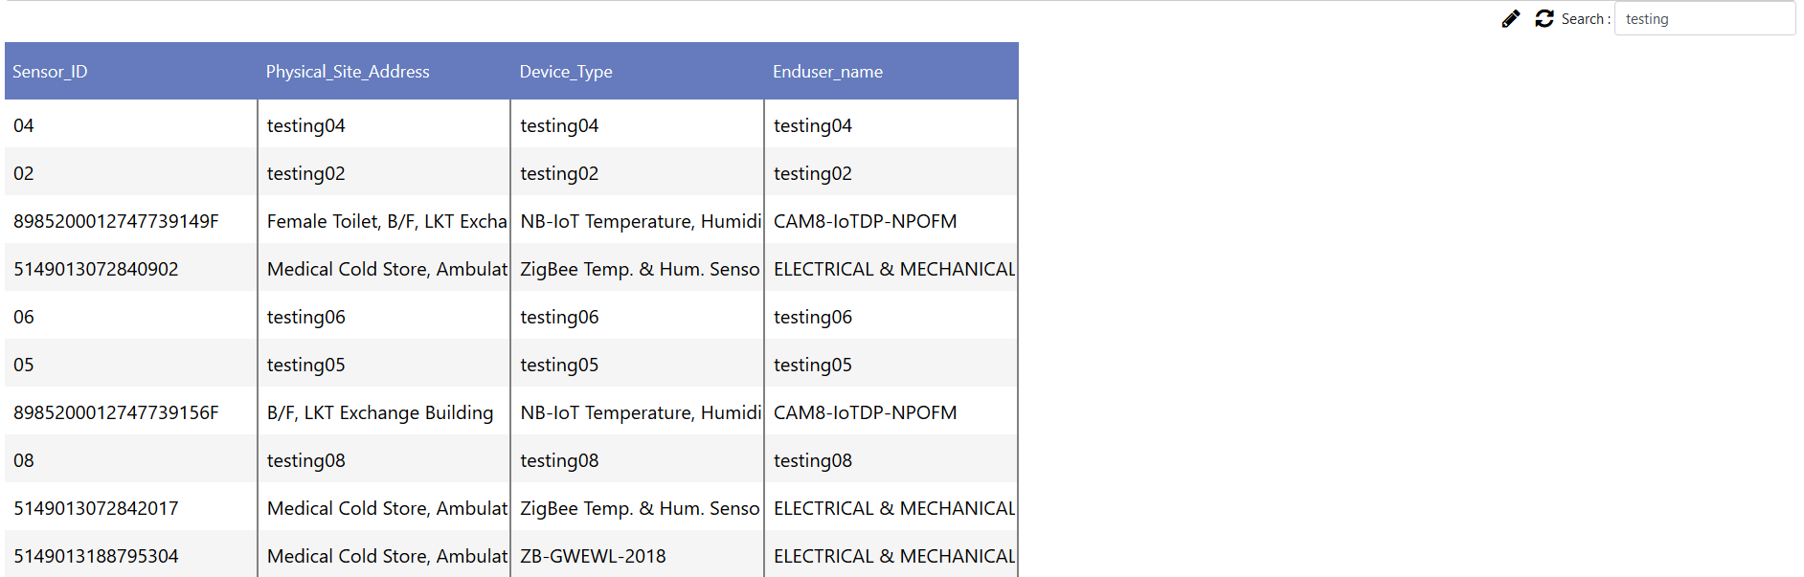
Refresh the table (Get updated data)

Slide 18
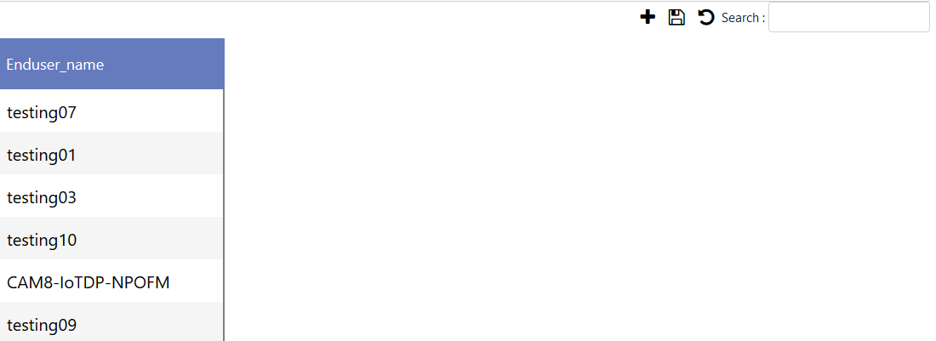
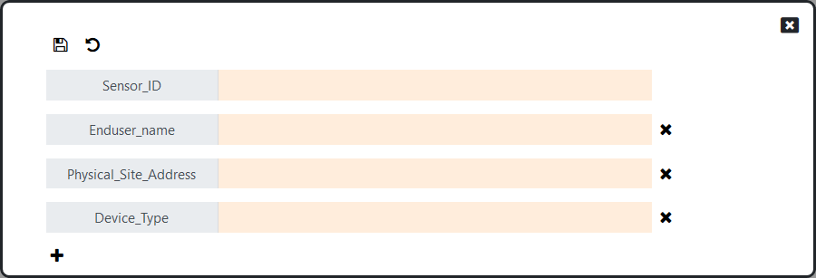
Edit the table
Add new entries
Rollback (Cancel)
Save the changed (Confirm)

Slide 19
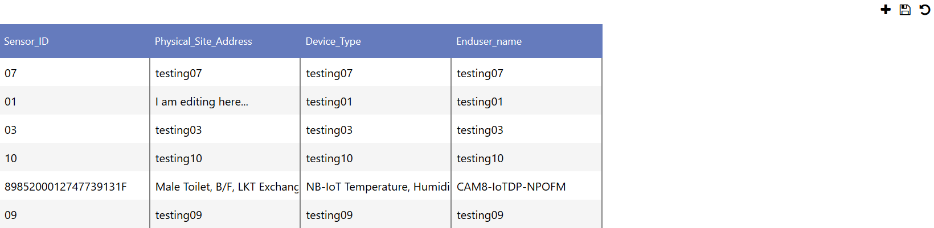
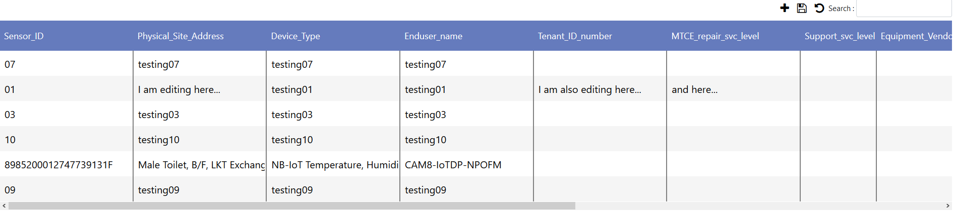
Edit the table (continue)
The table becomes editable
The records are editable even if the entry does not contain the records before

